Slide 1
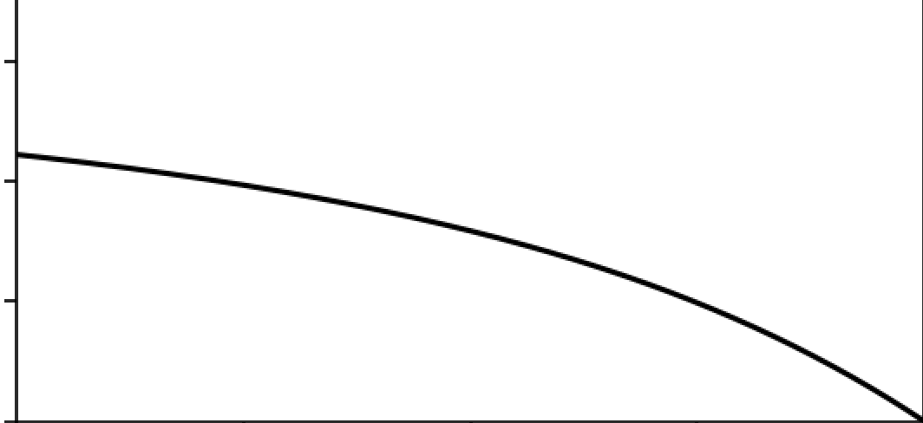
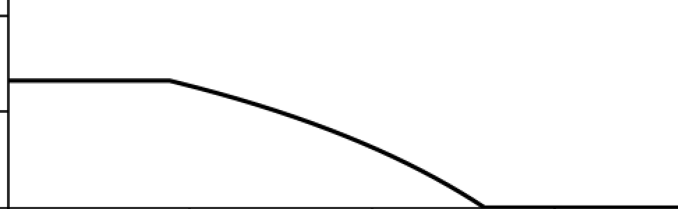



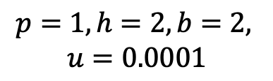










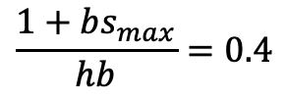




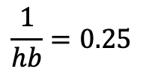



Conjectured optimal schedule of BVOC production
if all rates are constant
Iwasa et al.
Fig. 1
$$0.6$$
$$λ\left(t\right)$$
$$\frac{1+bs_{max}}{hb}=0.4$$
marginal value
of leaf area
$$0.4$$
$$λ\left(t\right)$$
$$\frac{1}{hb}=0.25$$
$$0.2$$
$$λ\left(t\right)$$
$$0$$
$$t_{f}$$
$$t$$
$$t_{s}$$
$$T$$
$$0.2$$
$$s_{max}$$
investment in
BVOC production
$$p=1, h=2, b=2,$$
$$u=0.0001$$
$$s\left(t\right)$$
$$0.1$$
$$0$$
$$t_{f}$$
$$t$$
$$t_{s}$$
$$T$$

Slide 2
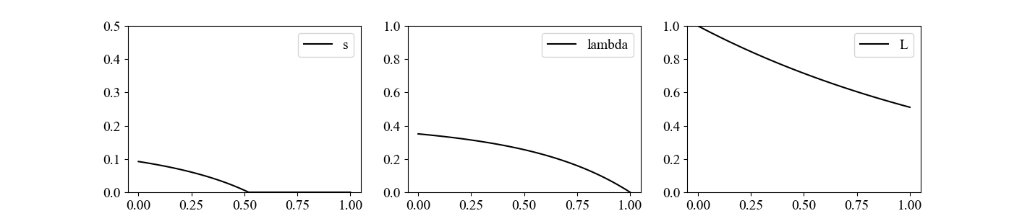
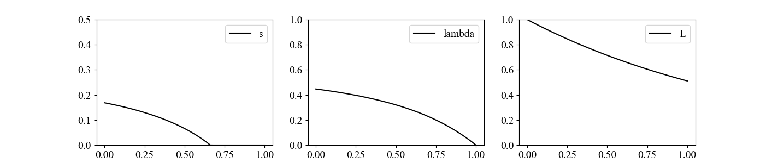
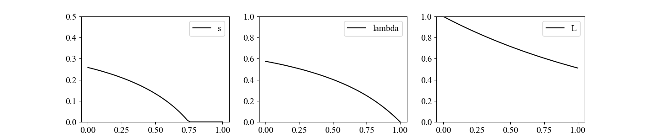






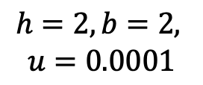

Iwasa et al.
Fig. 2
dependence on photosynthesis p
marginal value
of leaf area
leaf area
BVOC production
$$s\left(t\right)$$
$$λ\left(t\right)$$
$$L\left(t\right)$$
$$p=0.8$$
$$p=1$$
$$h=2, b=2,$$
$$u=0.0001$$
$$p=1.25$$
time
$$t$$

Slide 3
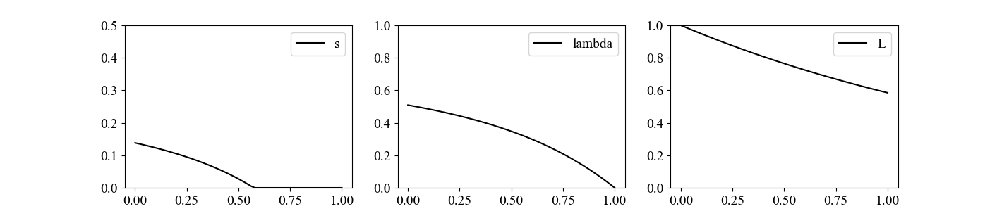
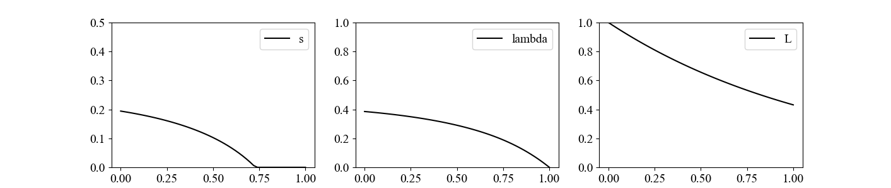
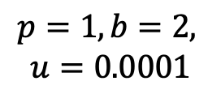



Iwasa et al.
Fig. 3
dependence on heat stress intensity h
marginal value
of leaf area
leaf area
BVOC production
$$s\left(t\right)$$
$$λ\left(t\right)$$
$$L\left(t\right)$$
$$h=1.6$$
$$h=2$$
$$p=1,b=2,$$
$$u=0.0001$$
$$h=2.5$$
time
$$t$$

Slide 4
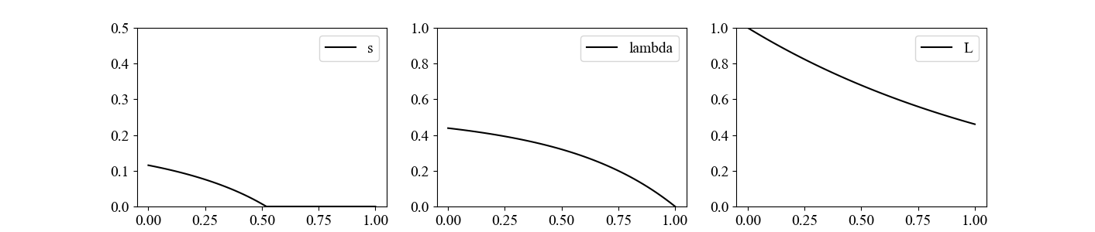
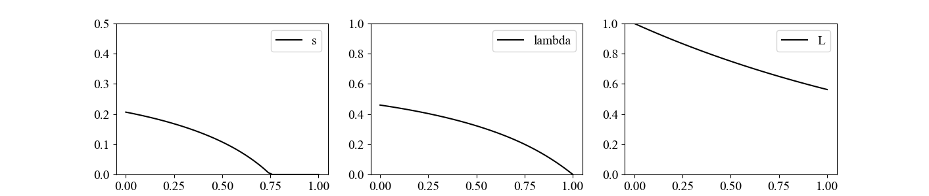






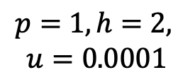
Iwasa et al.
Fig. 4
dependence on BVOC effectiveness a
marginal value
of leaf area
leaf area
BVOC production
$$s\left(t\right)$$
$$λ\left(t\right)$$
$$L\left(t\right)$$
$$b=1.6$$
$$b=2$$
$$p=1, h=2,$$
$$u=0.0001$$
$$b=2.5$$
time
$$t$$

Slide 5










Iwasa et al.
Fig. 5
dependence on rate of random loss u
marginal value
of leaf area
leaf area
BVOC production
$$s\left(t\right)$$
$$λ\left(t\right)$$
$$L\left(t\right)$$
$$u=0.0008$$
$$u=0.0001$$
$$p=1, h=2,$$
$$b=2$$
$$u=0.000125$$
time
$$t$$

Slide 6
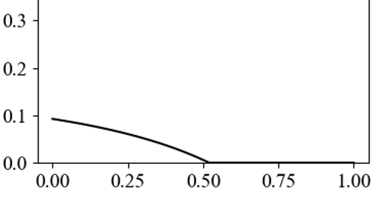
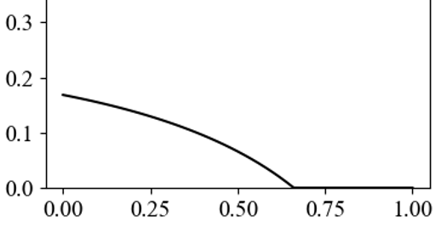
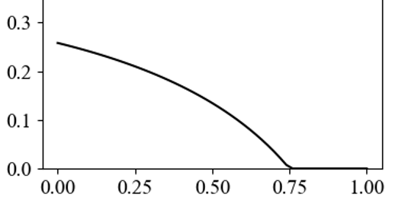
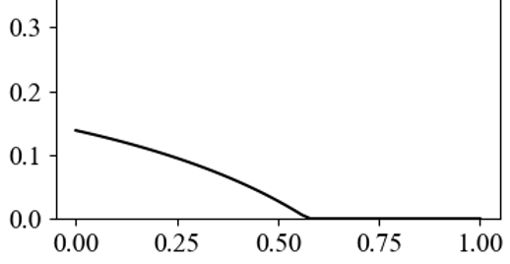

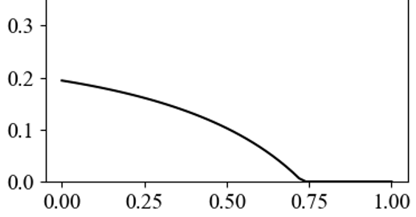
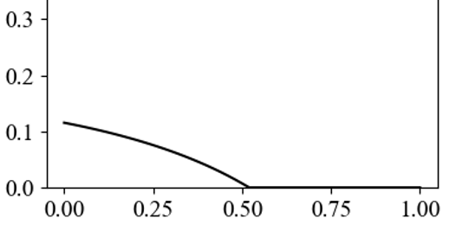

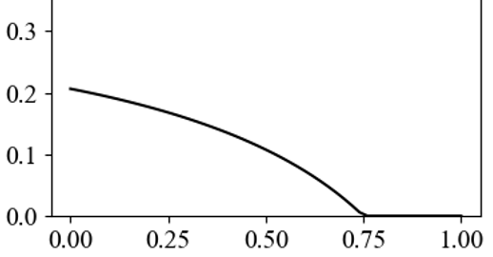
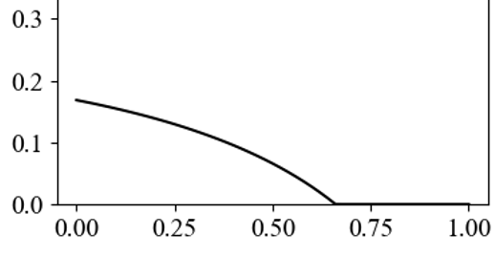

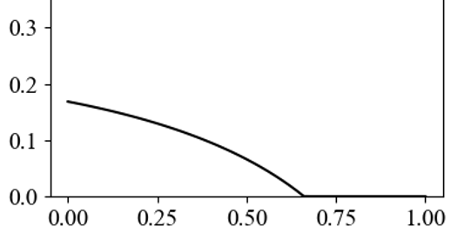










dependence on parameters
Iwasa et al.
Fig. 2
BVOC production
$$s\left(t\right)$$
$$p=1, h=2, b=2, u=0.0001$$
$$×\frac{4}{5}$$
$$×1$$
$$×\frac{5}{4}$$
$$p$$
$$h$$
$$b$$
$$u$$
time
$$t$$

Slide 7
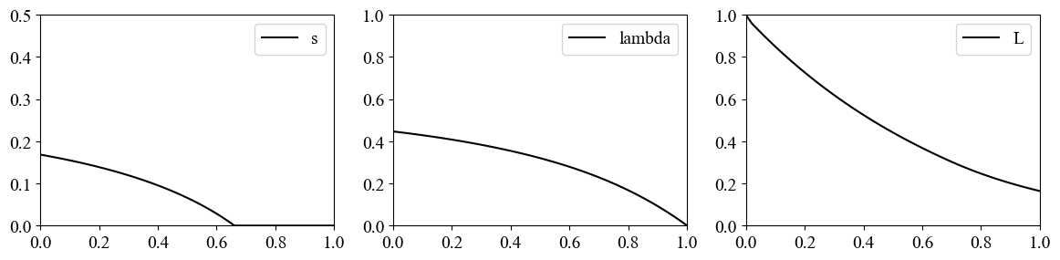
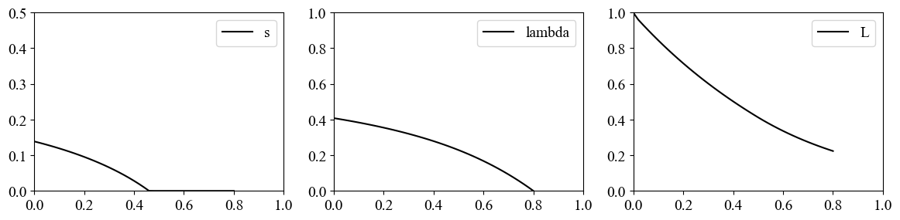
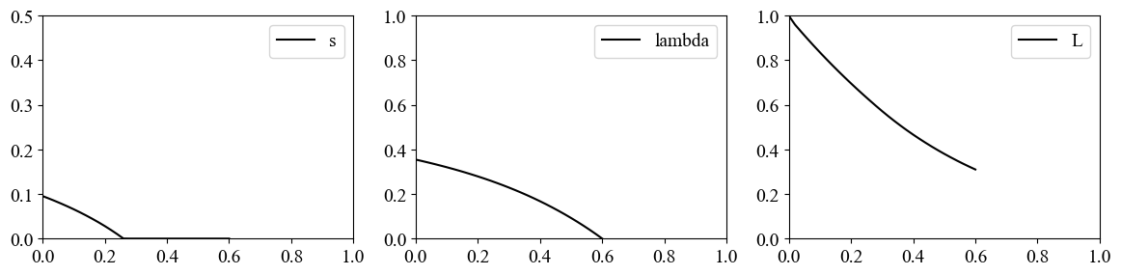



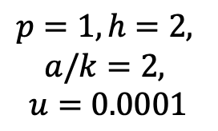




dependence on length of season T
Iwasa et al.
Fig. 6
7
BVOC production
marginal value
of leaf area
leaf area
the optimal solution is determined by T-t
$$s\left(t\right)$$
$$λ\left(t\right)$$
$$L\left(t\right)$$
$$T=1$$
$$T=0.8$$
$$p=1, h=2,$$
$$a/k=2,$$
$$u=0.0001$$
$$T=0.6$$
time
$$t$$

Slide 8
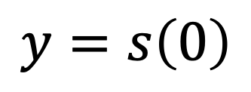

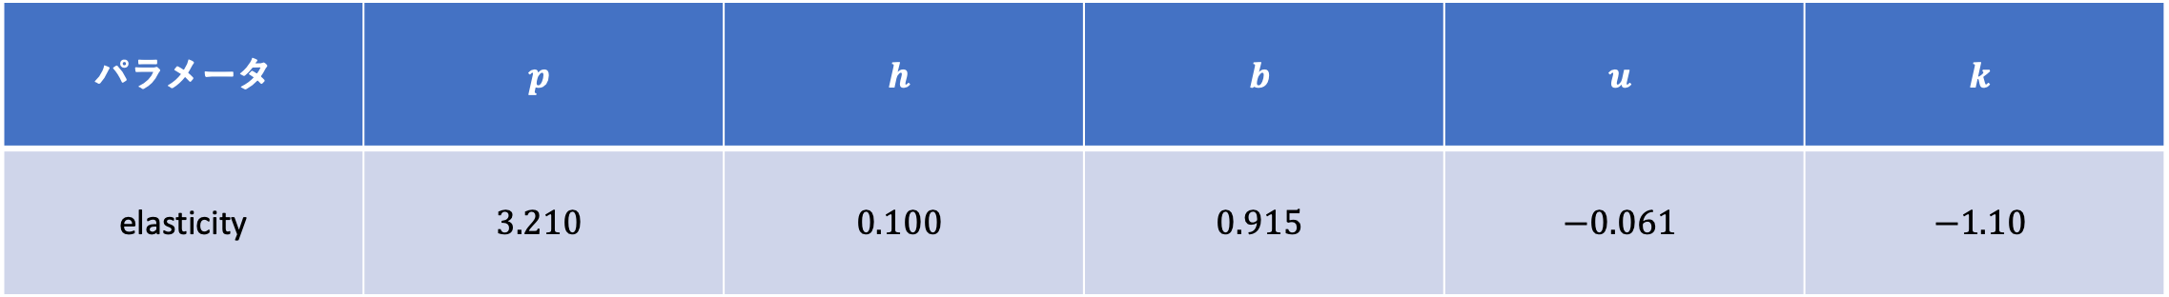
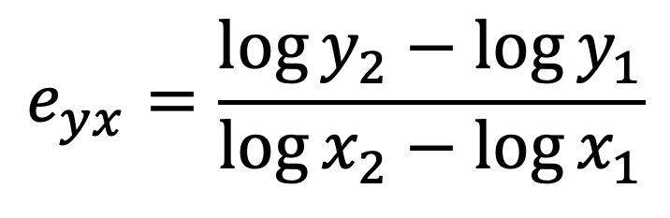
effect of enhanced $x$ on the change in
$$y=s\left(0\right)$$
$$e_{yx}=\frac{\log{y_{2}}−\log{y_{1}}}{\log{x_{2}}−\log{x_{1}}}$$
elasticity
パラメータ | $$p$$ | $$h$$ | $$b$$ | $$u$$ | $$k$$
elasticity | $$3.210$$ | $$0.100$$ | $$0.915$$ | $$−0.061$$ | $$−1.10$$
求め方
large
positive
small
positive
positive
close to
zero

Slide 9

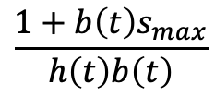






















Conjectured optimal seasonal schedule
Iwasa et al.
Fig. 7
heat stress
h$\left(t\right)$
$$0$$
$$\frac{1+b\left(t\right)s_{max}}{h\left(t\right)b\left(t\right)}$$
marginal value
of leaf area
$$\frac{1}{h\left(t\right)b\left(t\right)}$$
$$λ\left(t\right)$$
$$λ\left(t\right)$$
$$λ\left(t\right)$$
$$0$$
$$t_{f}$$
$$t_{s1}$$
$$t_{f1}$$
$$t_{f2}$$
$$t_{s2}$$
$$T$$
$$s_{max}$$
BVOC
production
$$s\left(t\right)$$
$$0$$
$$0$$
$$t_{s1}$$
$$t_{f1}$$
$$t$$
$$t_{f2}$$
$$t_{s2}$$
$$T$$

Slide 10
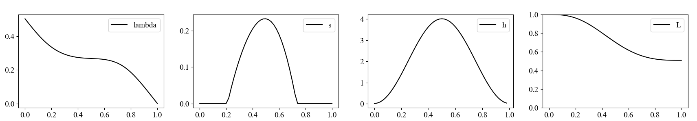
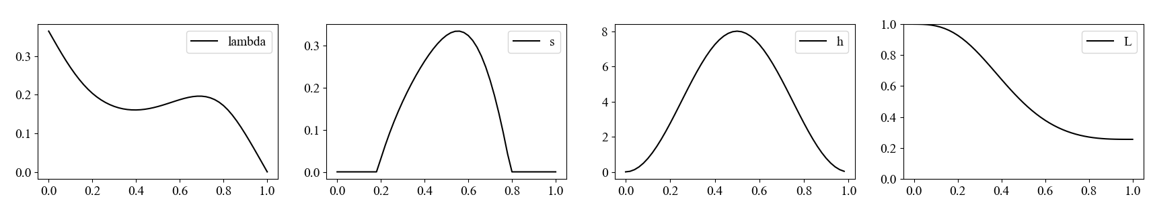




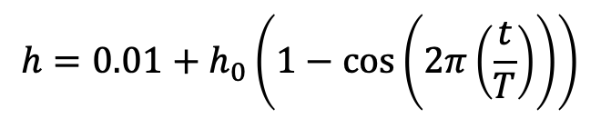







$$p=1, h=2, a/k=2, u=0.0001,$$
Iwasa et al.
Fig. 8
$$h=0.01+h_{0}\left(1−\cos\left(2π\left(\frac{t}{T}\right)\right)\right)$$
BVOC production
heat stress
$$h_{0}=2$$
$$λ\left(t\right)$$
$$s\left(t\right)$$
$$h\left(t\right)$$
$$L\left(t\right)$$
BVOC production
heat stress
$$h_{0}=4$$
$$λ\left(t\right)$$
$$s\left(t\right)$$
$$h\left(t\right)$$
$$L\left(t\right)$$
BVOC is produced only in the summer

Slide 11
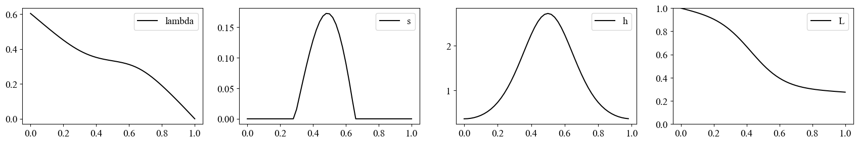
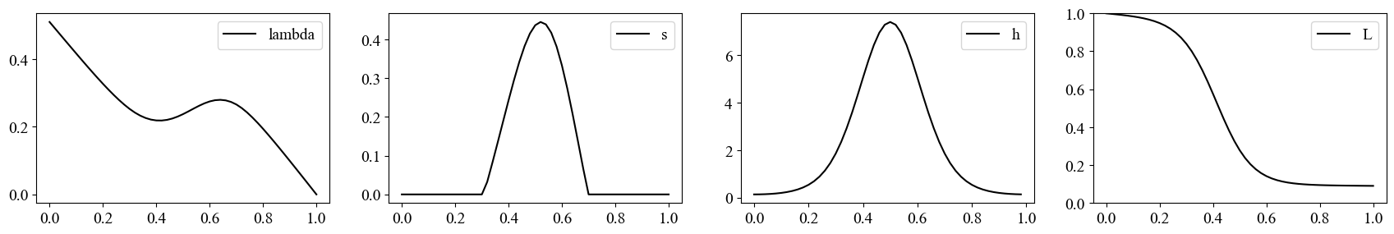
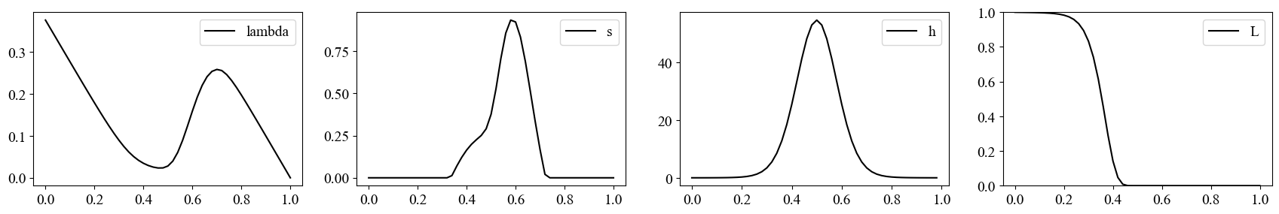

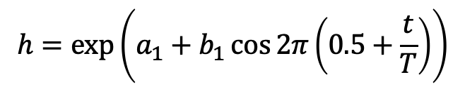




$$p=1, a=2, u=0.0001, k=1,$$
Iwasa et al.
Fig. 9
$$h=\exp\left(a_{1}+b_{1}\cos{2π}\left(0.5+\frac{t}{T}\right)\right)$$
$$a_{1}=0$$
marginal value
BVOC production
heat stress
leaf area
$${ b}_{1}=1$$
$$b_{1}=2$$
$$b_{1}=4$$
BVOC is produced more after the peak stress

Slide 12
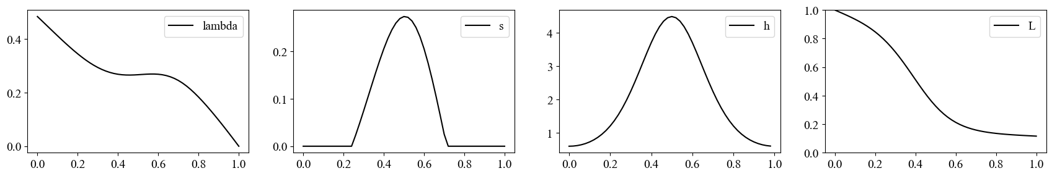
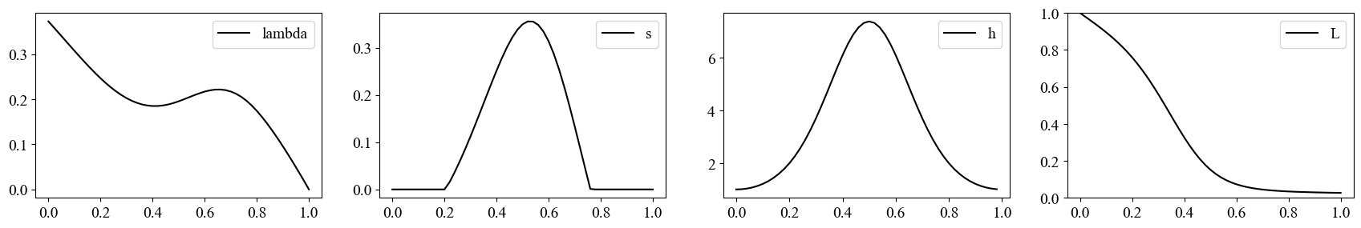




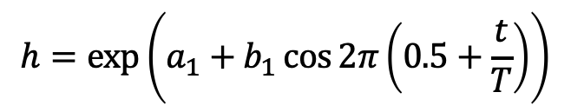

Change in the magnitude of heat stress
with keeping the same shape
$$p=1, a=2, u=0.0001, k=1,$$
Iwasa et al.
Fig. 9
$$h=\exp\left(a_{1}+b_{1}\cos{2π}\left(0.5+\frac{t}{T}\right)\right)$$
$$b_{1}=1$$
marginal value
BVOC production
heat stress
leaf area
$$a_{1}=0$$
$$a_{1}=0.5$$
$$a_{1}=1$$
Marginal value of leaf area is higher after the peak heat stress

Slide 13
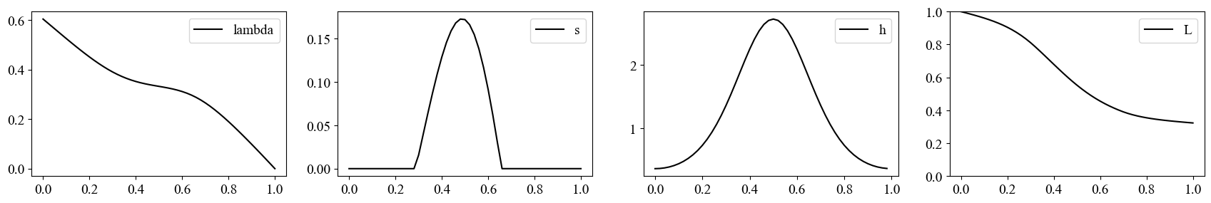
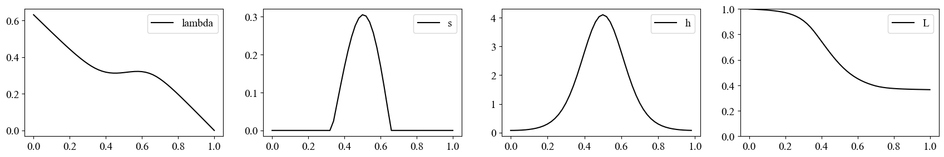
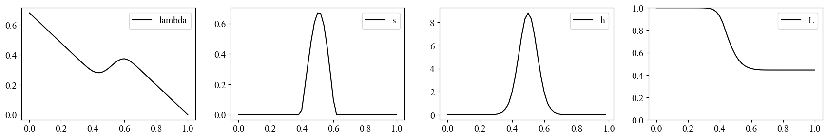










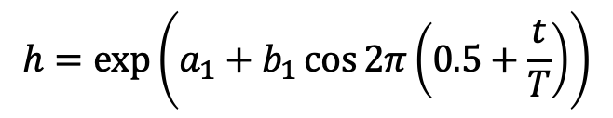

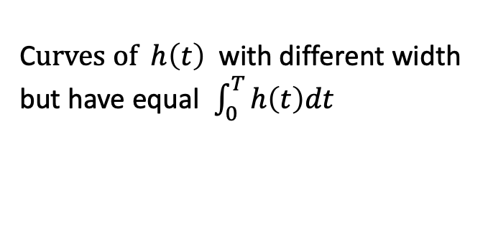
$$p=1, b=2, u=0.0001$$
C$urves of h\left(t\right)$ with different width
but have equal $\int_{0}^{T}{h\left(t\right)dt}$
$$h=\exp\left(a_{1}+b_{1}\cos{2π}\left(0.5+\frac{t}{T}\right)\right)$$
BVOC production
heat stress
$$λ\left(t\right)$$
$$s\left(t\right)$$
$$h\left(t\right)$$
$$L\left(t\right)$$
$$a_{1}=0,$$
$${ b}_{1}=1$$
$$a_{1}=−0.588,$$
$${ b}_{1}=2$$
$$a_{1}=−5.822,$$
$${ b}_{1}=8$$
Shift of the peak BVOC production date was small
because the loss of leaves in the mid-summer was mild.

Slide 14
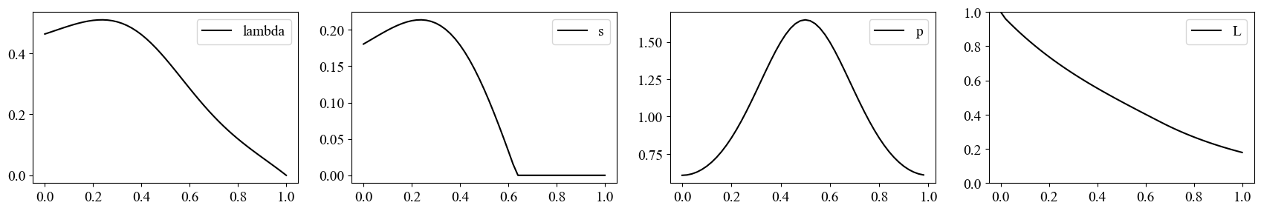







If photosynthesis p peaks in mid-summer
$$p=\exp\left(a_{1}+b_{1}\cos{2π}\left(0.5+\frac{t}{T}\right)\right),$$
$$h=2, b=2, u=0.0001$$
$$a_{1}=0, { b}_{1}=0.5$$
$$λ\left(t\right)$$
$$s\left(t\right)$$
$$p\left(t\right)$$
$$L\left(t\right)$$
BVOC production peaks
in early summer
photosynthesis p
leaf area
If photosynthetic rate peaks in mid-summer
BVOC production peaks in early summer
(rather than the mid-summer).

Slide 15








If efficiency of BVOC b drops in summer due to high volatility
$$b=2\exp\left(a_{1}+b_{1}\cos{2π}\left(0.5+\frac{t}{T}\right)\right),$$
$$p=1, h=2, u=0.0001,$$
$$a_{1}=0, { b}_{1}=−0.5$$
$$λ\left(t\right)$$
$$s\left(t\right)$$
$$1/b\left(t\right)$$
$$L\left(t\right)$$
BVOC production
stops in summer
inverse of b
leaf area is lost
rapidly in autumn
If BVOC effect declines in the mid-summer,
BVOC production peaks in the spring or in early summer
and no production occurs after the mid-summer.

